Slide 1
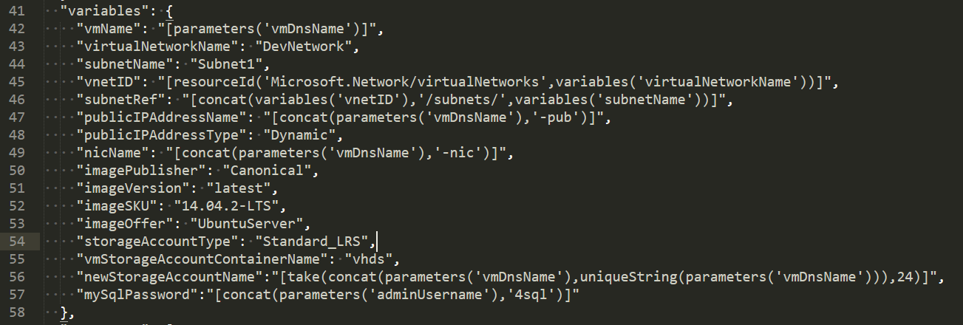
Make the following updates prior to importing the template into ServiceNow.
Valid Virtual Network name that exists in the Resource Group you are provisioning into.
(probably not “DevNetwork”)
Valid Subnet name that exists in the Virtual Network from the line above (may or may not be “Subnet1”)

Slide 2
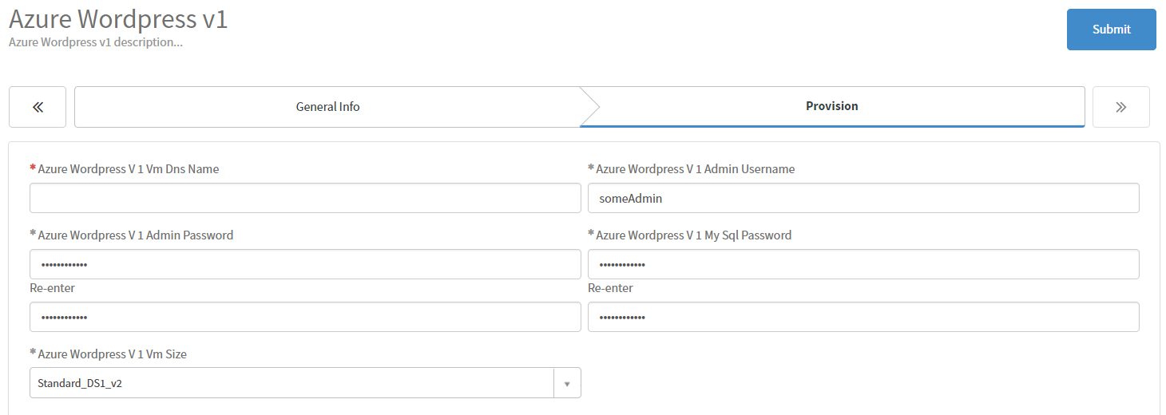
Typically use the “Stack Name” here from the “General Info” tab.

